Slide 1

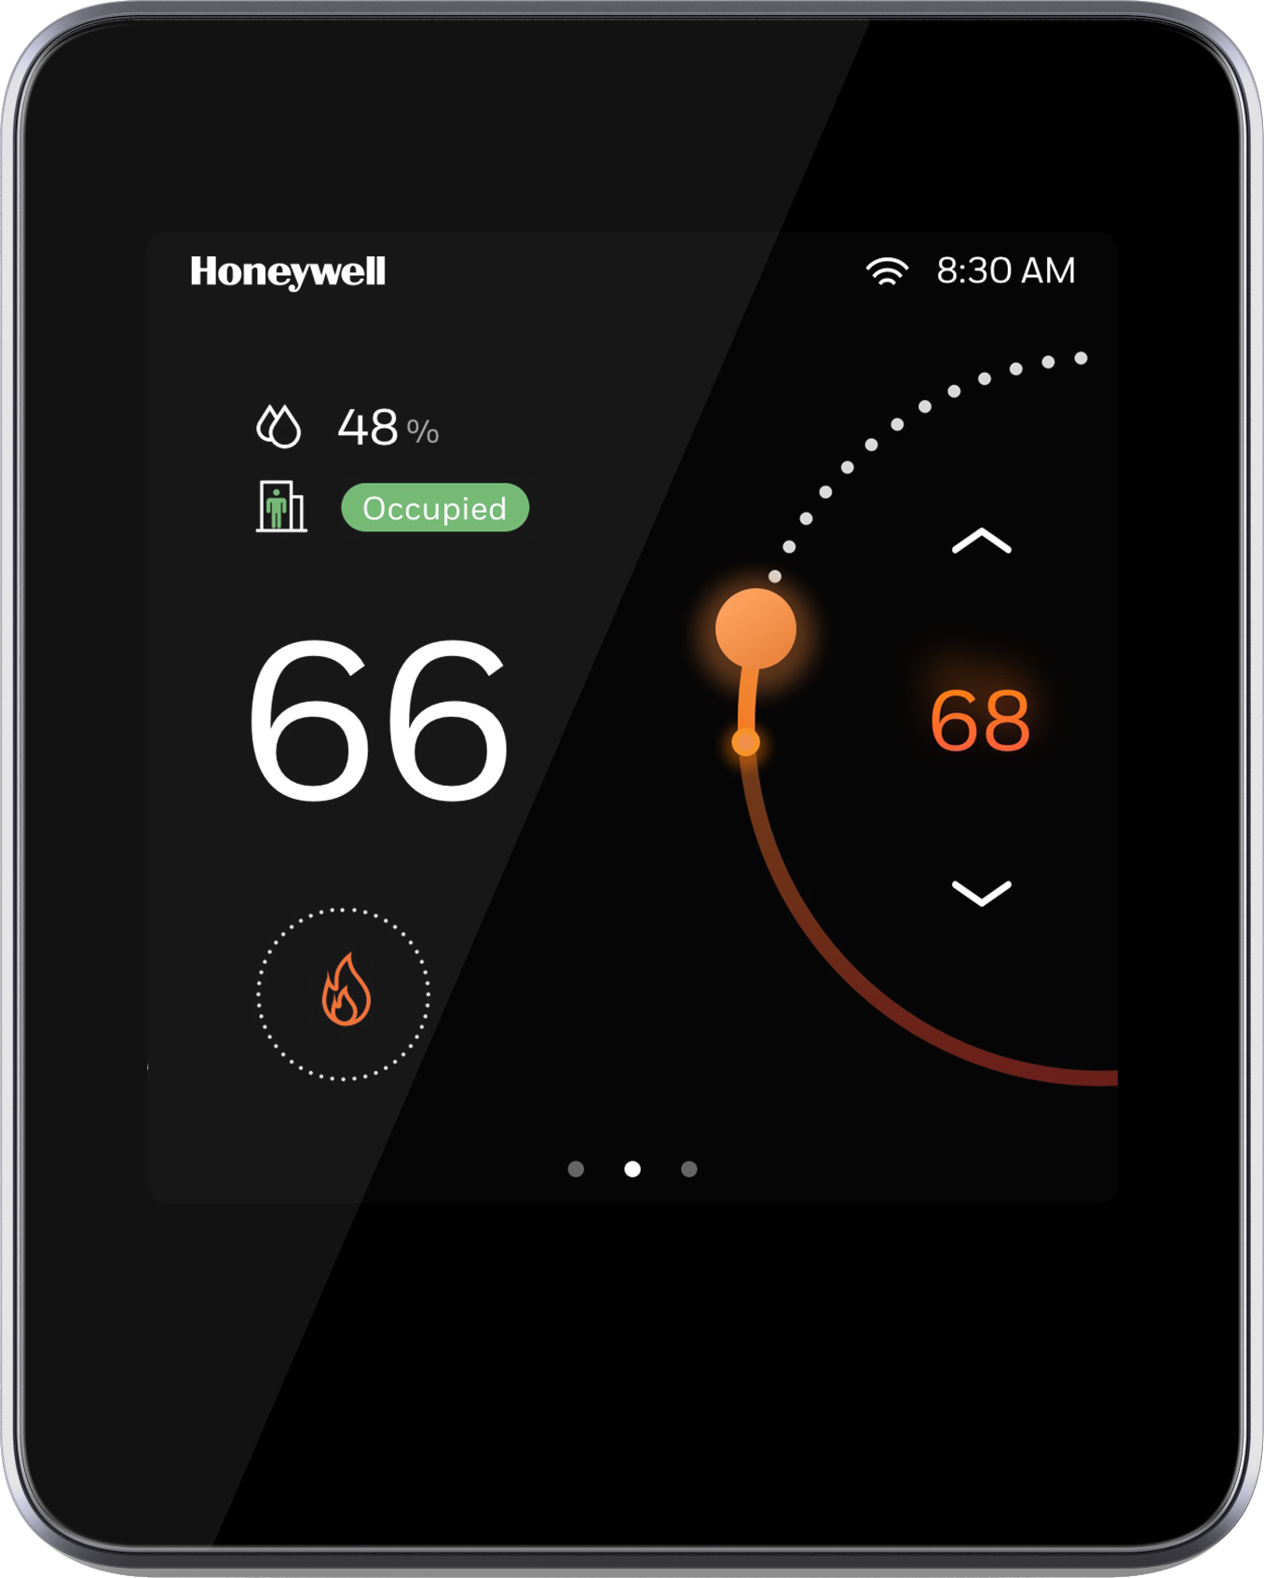
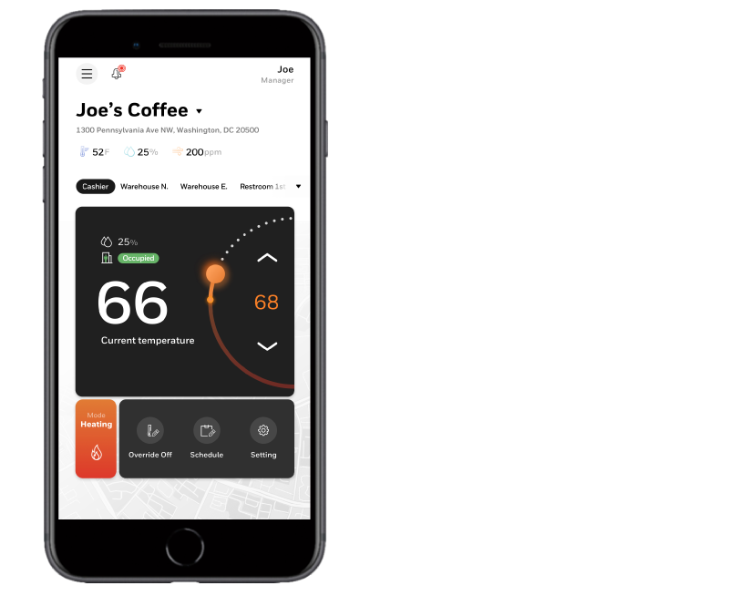
TC500 COMMERCIAL COMMUNICATING THERMOSTAT
April 2021

Slide 2
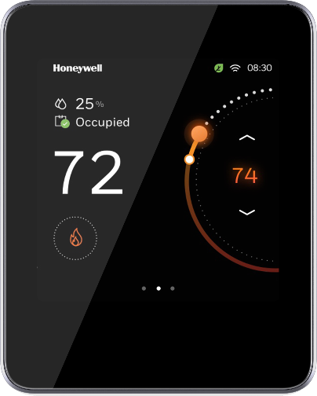

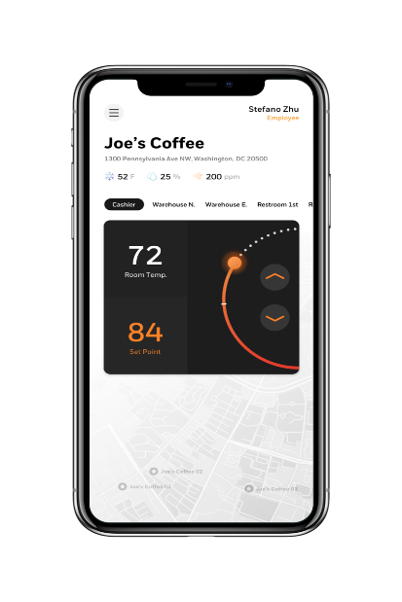

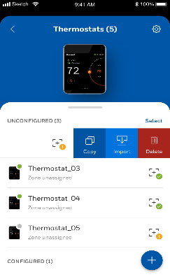
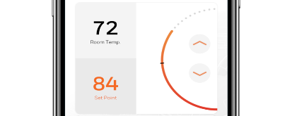
Introducing the TC500A-N thermostat
Ideal for retail, clinics, restaurants, hotels, schools, warehouses and other commercial businesses
For up to 3H/3C AHU, RTU, plus 5H/3C heat pump systems
Setup wizard cuts installation time
Integrated energy-saving features
Ideal comfort experience
Meets commercial building codes
Remote connectivity
Contractor app for commissioning
Occupant app for remote monitoring and control
Deco Plate: for retrofit applications
TC500A-N Thermostat: Facilitates auto-update
Connect Me App: Occupant app for remote monitoring and control
Connect Mobile App: Contractor deploy app (July 2021)

Slide 3

TC500A Video

Slide 4
TC500A-N Features – At a Glance
TC500A-N Features – At a Glance
Intuitive, Color Touch Screen Interface System status, temperature trend and system setup
Wired or Wireless Control WiFi, Bluetooth, BACnet IP & MS/TP, Sylk
Flexible Installation 3H/3C Conventional RTU/AHU or 5H/3C Heat Pump configurable inputs/outputs; (2) UI’s, (2) UIO’s
User Mobile App Remote setpoint & schedule changes
Contractor Mobile App Commissioning
Multi-Level User Types Contractor, advanced and basic users
Scalable Control Upgradable to provide advanced energy saving analytics for multi-site businesses
Honeywell Name Commercial grade design with a 5-year warranty
TC500 Series

Slide 5

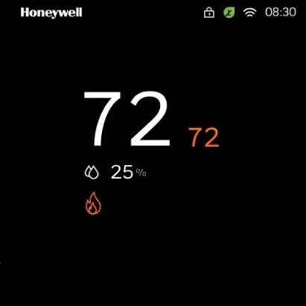
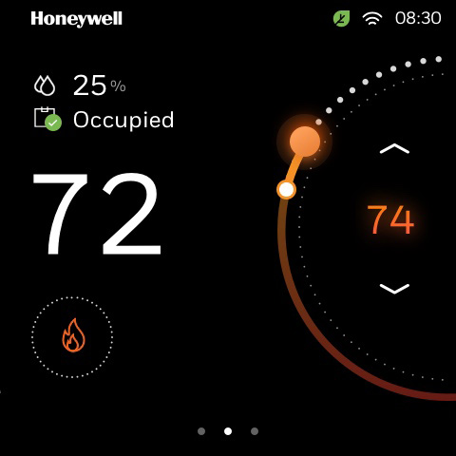
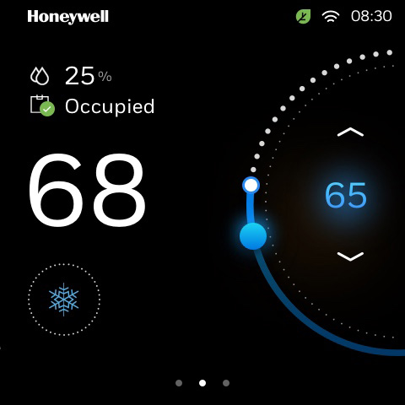
Guided tour - home screen
Locked screen
(display only)
Unlocked screen
Heat Mode
Unlocked screen
Cool Mode
Configurable display settings
Cyber secure WiFi connection
Current Temp
Intuitive Setpoint Change
System Mode
Built-in Logic provides optimum energy efficiency
Notes:
“Home” screen is configurable to be either Locked (display only) or Unlocked (interactive ability to change setpoint, system mode)
User can change setpoint by either dragging colored dot or tapping on arrows
Color scheme changes from Orange (Heat mode) to Blue (Cool mode)
Icon changes from orange flame to blue snowflake

Slide 6
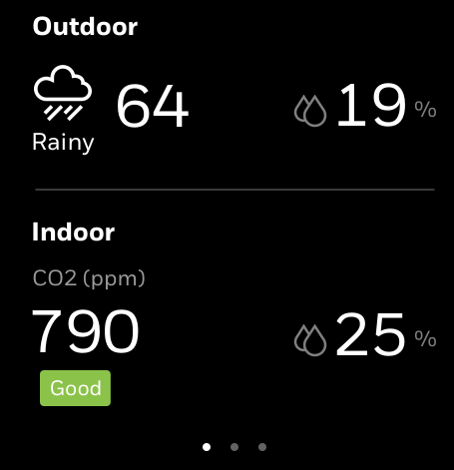
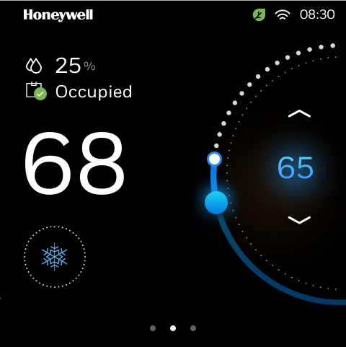
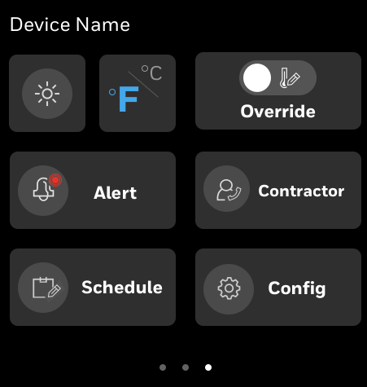
Guided tour - Home screen Views
Left
Center
Right
Home screens will vary based on configuration.

Slide 7




Guided tour -
customized discrete home Screen
Heating Mode
Cooling Mode
Fan only Mode
Screen on
Lighting off
Interact by touch screen
Screen off
Lighting on
Heating model: the orange
bar lighting breathing when heating.
The orange lighting on, when indoor temperature meet target temperature.
Screen off
Lighting on
Cooling model: the blue
lighting on, when indoor temperature meet target temperature.
Screen off
Lighting on
Fan model: the white
ring on

Slide 8
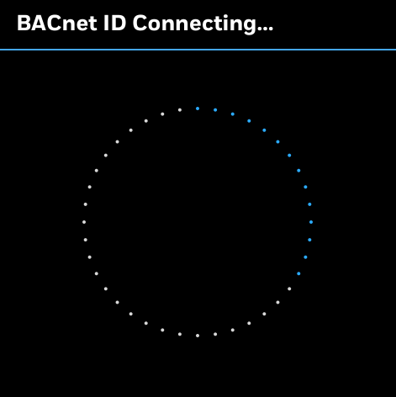
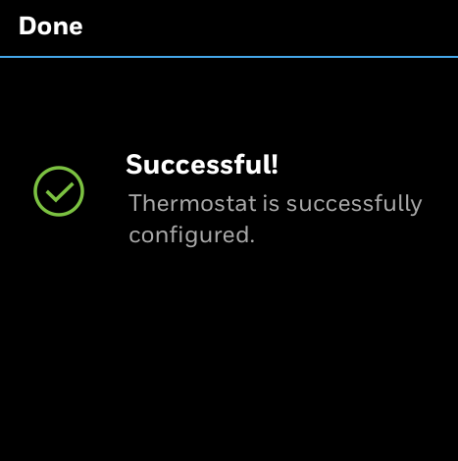
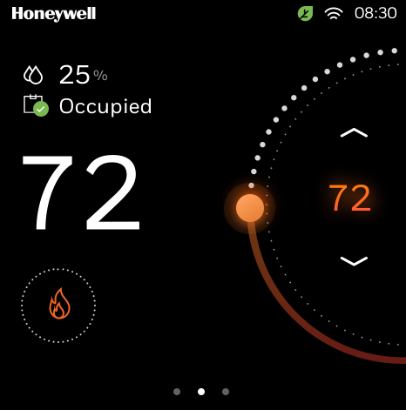
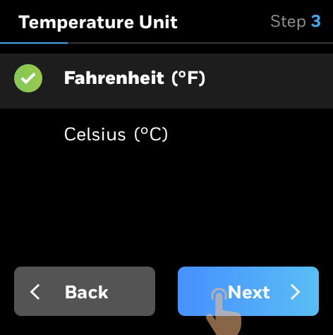
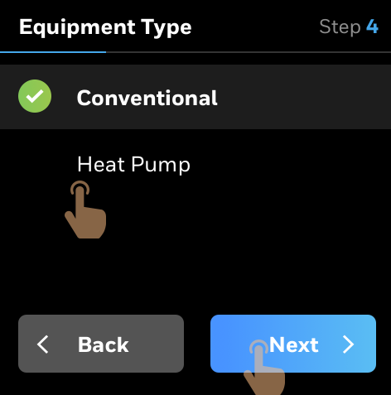
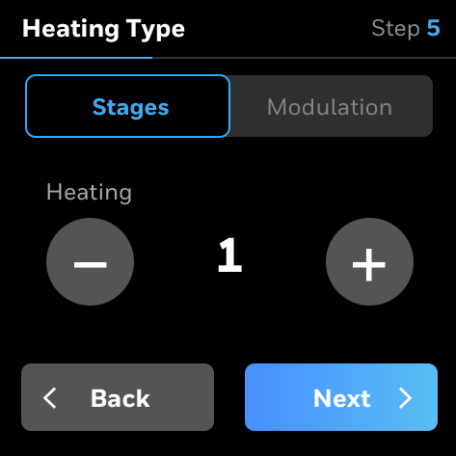
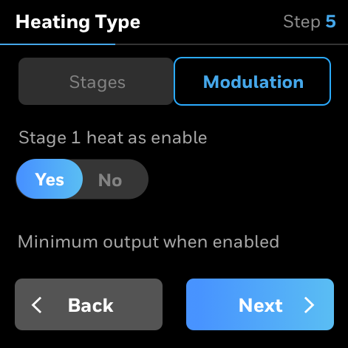
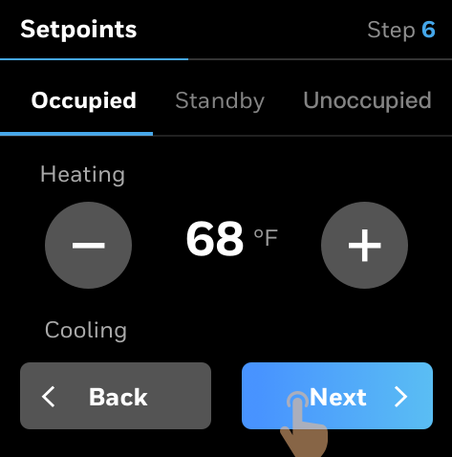
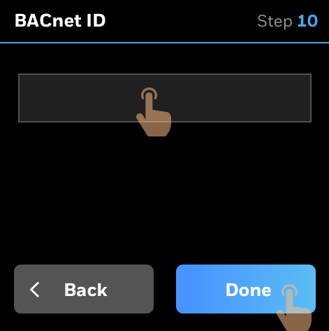
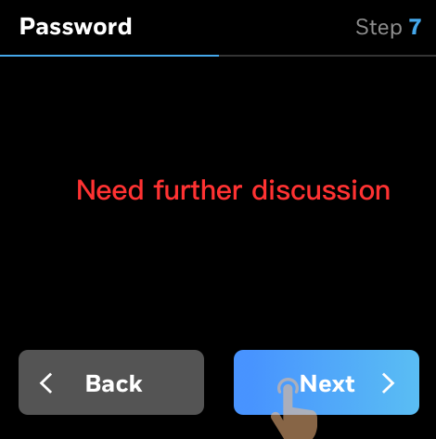
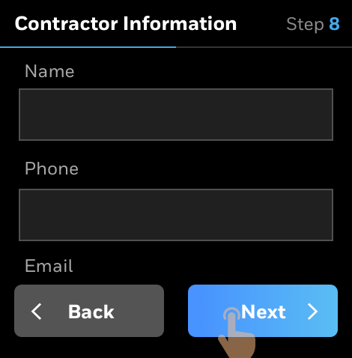
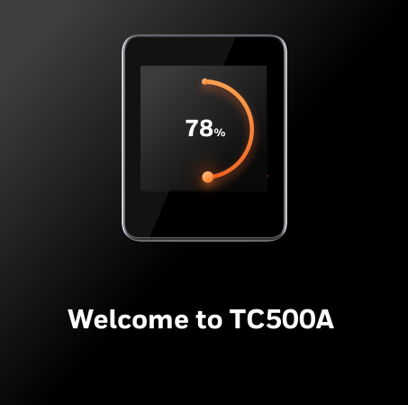
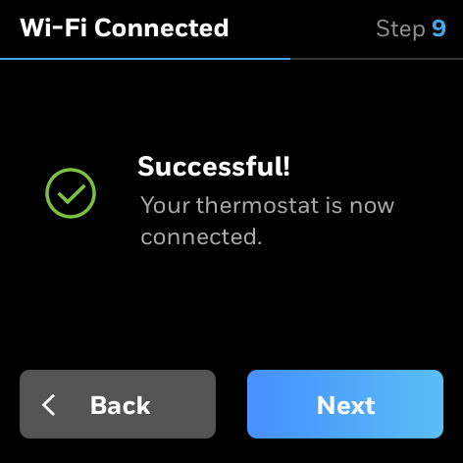
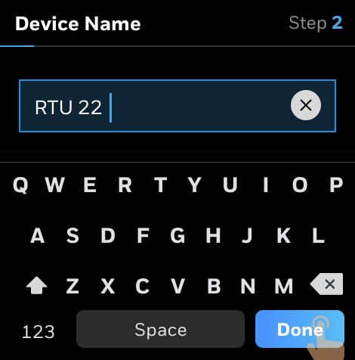
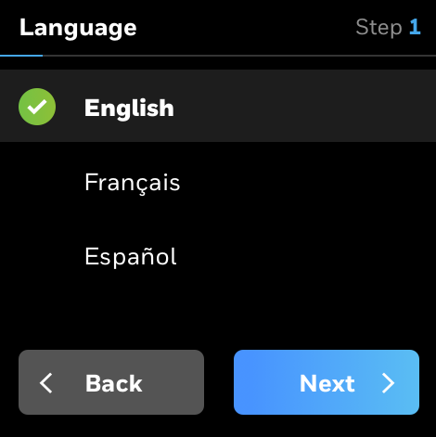
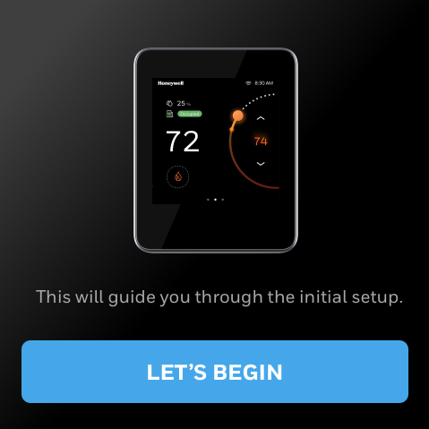
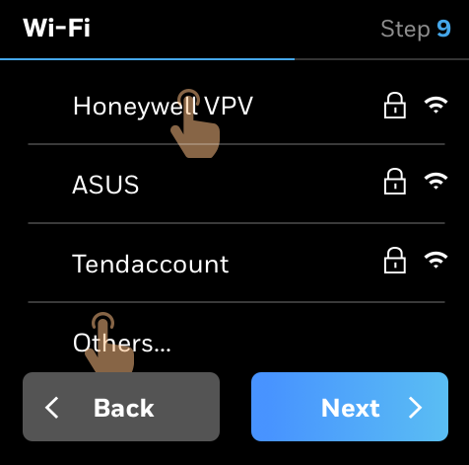
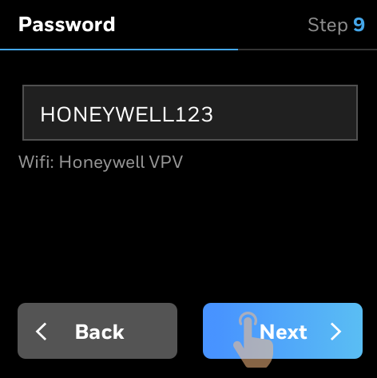

Contractor
Setup wizard
Enter contact information for your customers
Manage conventional heating and cooling
Manage heat pump
Simple Setup

Slide 9
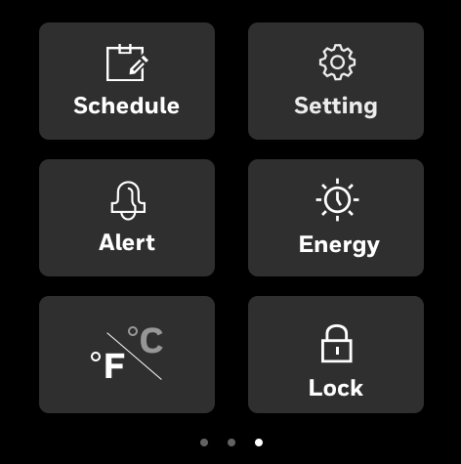
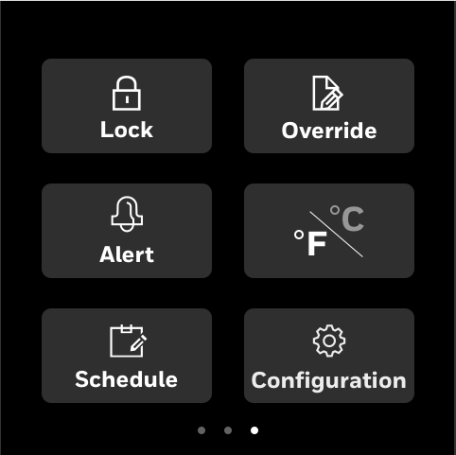
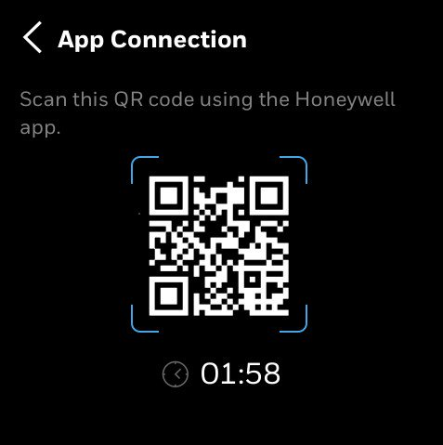
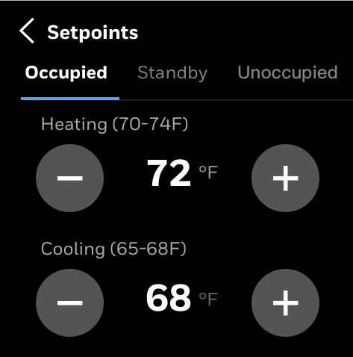
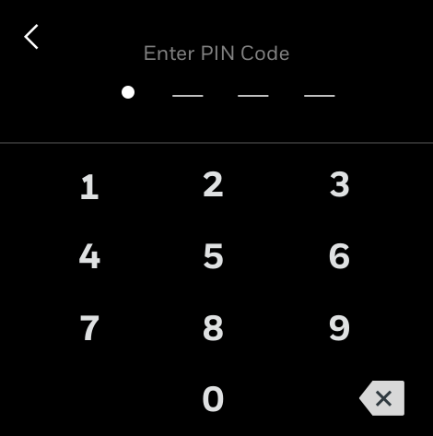
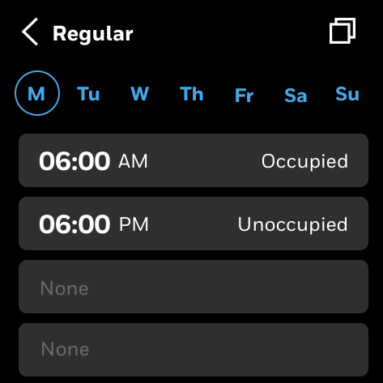
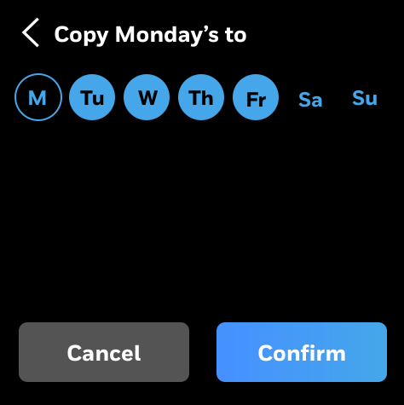
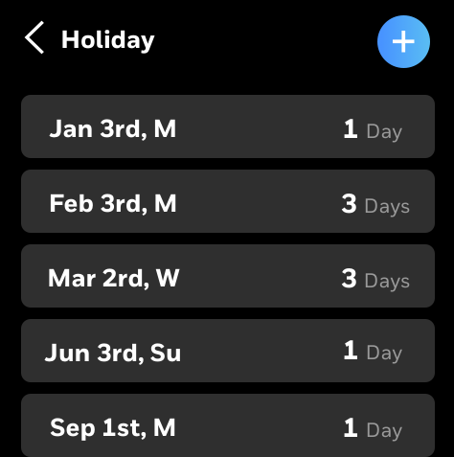
Easy Facility
Manager control
Connect thermostat and app with QR code
Customize quick access tools on home screen
Adjust setpoints
Regular and holiday scheduling options
Passcode protected multi-user level access

Slide 10
Detailed SPECIFICATIONS
TC500 Series Specifications
Up to 3H/3C conventional (Gas, Oil, Electric) with configurable I/O; 5H/3C Heat Pump
365-day programmability with Holiday scheduling, Temp overrides
WiFi, Bluetooth, BACnet over WiFi, BACnet MS/TP (future), Sylk connectivity
4” Color Capacitive Touch display
Configurable fan speeds
On Board Temperature, Humidity, Proximity sensors
Remote Sensor support: Temperature & Averaging, Outdoor Temperature, OAT Lockouts, Discharge Air, DAT Lockouts, Humidity, Occupancy, VOC, CO2
Sylk sensors supported: TR40 series, C7400S, MS3130J (future)
Tamper-proof housing
Installation/Commissioning via thermostat and App
Auto-changeover Heat/Cool setpoints or Single setpoint; Configurable Deadband (2-9 degrees)
Certification/Stewardship: CA Title 24, UL, FCC Part 15 Class B, CE, ASHRAE, BTL, LEEDS, RoHS, REACH, IEEC
Configurable Reminders/Alerts (Filter, UV, Hum, Dehum, Vent)

Slide 11
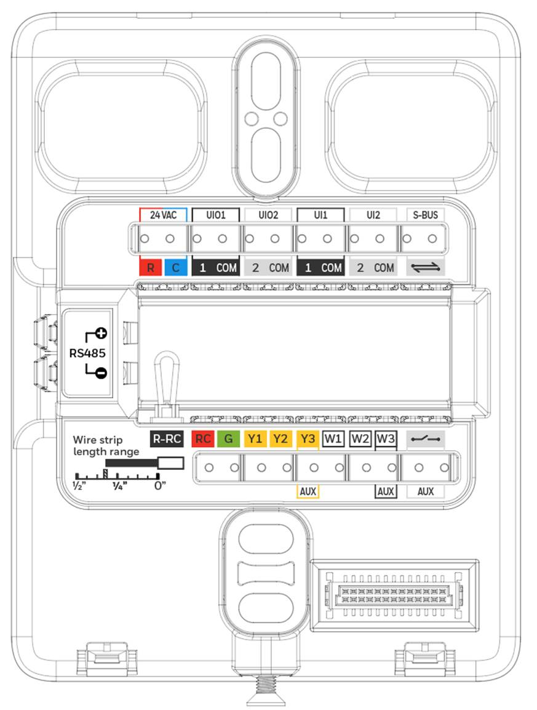
Terminal assignments
TC500A – Better RTU
Designed for optimal flexibility, supporting the most common default and optional terminal assignments.
Up to 3H/3C
(2) UI terminals
(2) UIO terminals
Spring-loaded wire insertion
Color-coded terminals for ease of installation

Slide 12
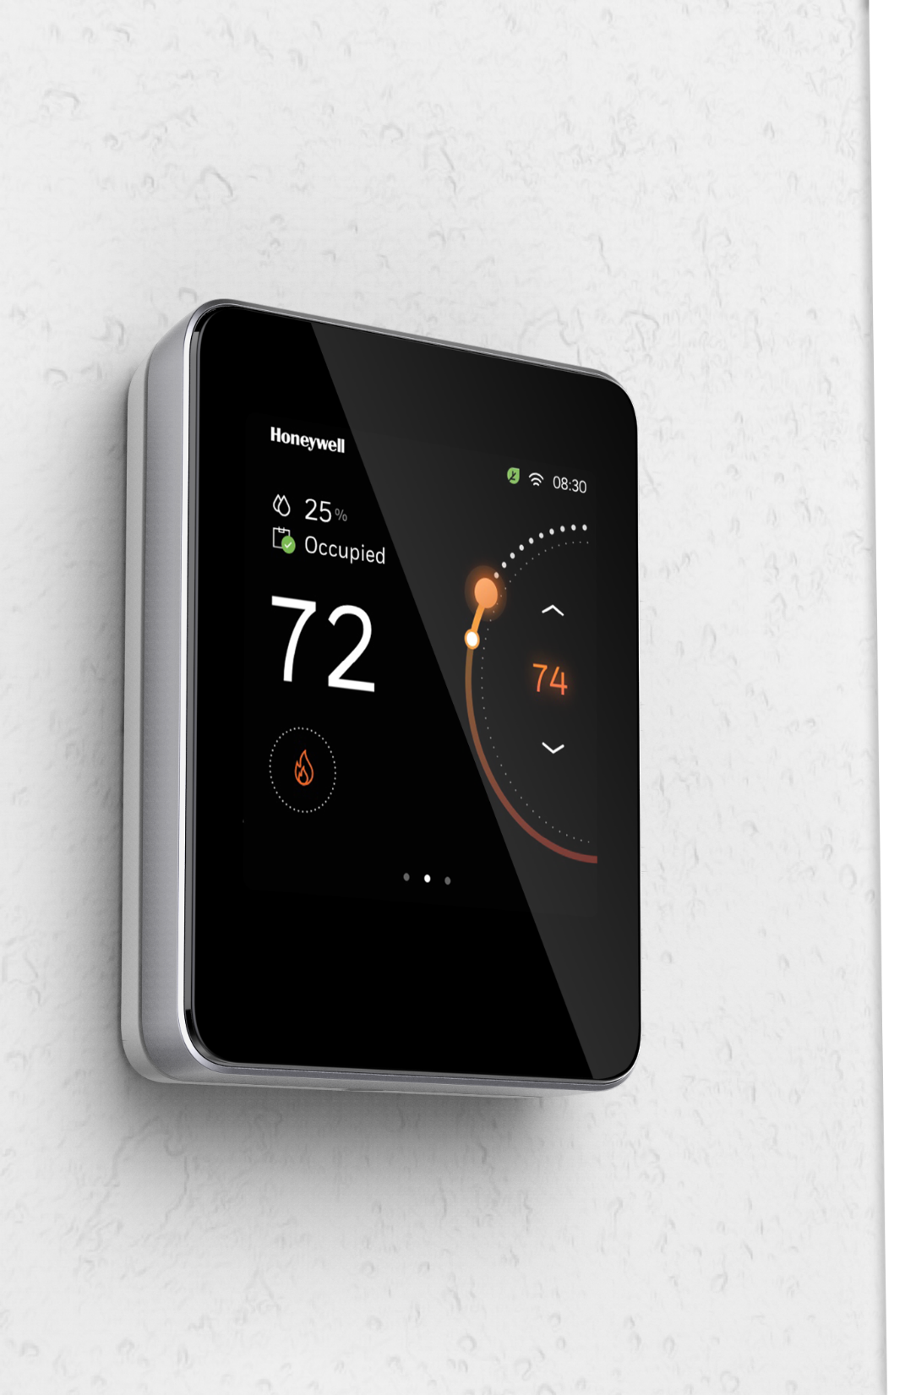

IDEAL applications
Applications Desiring Upscale Look & Feel
Corporate Offices
Upscale Hotels
Condominiums
Small and Medium Buildings
Retail
Restaurants
Hospitality

Slide 13

Perfect solution for sm-med buildings
Fewer Locations or Thermostats
Many Locations or Thermostats
Stand Alone Thermostat
Connect directly to cloud for App
Managed locally
Alerts, no data storage or analytics
SMB Portfolio Management
Connects through Gateway
Centrally managed
Includes data storage & analytics
Upgradeable to the Honeywell Small & Medium Building Administrator Powered by Honeywell Forge
Notes:
When a business is no longer able to manage locations locally, they will be encouraged to upgrade to the SMB solution for centrally managed solution. Same thermostat will support, but will add Gateway, Meter & Smart I/O, and switch to SMB App.

Slide 14
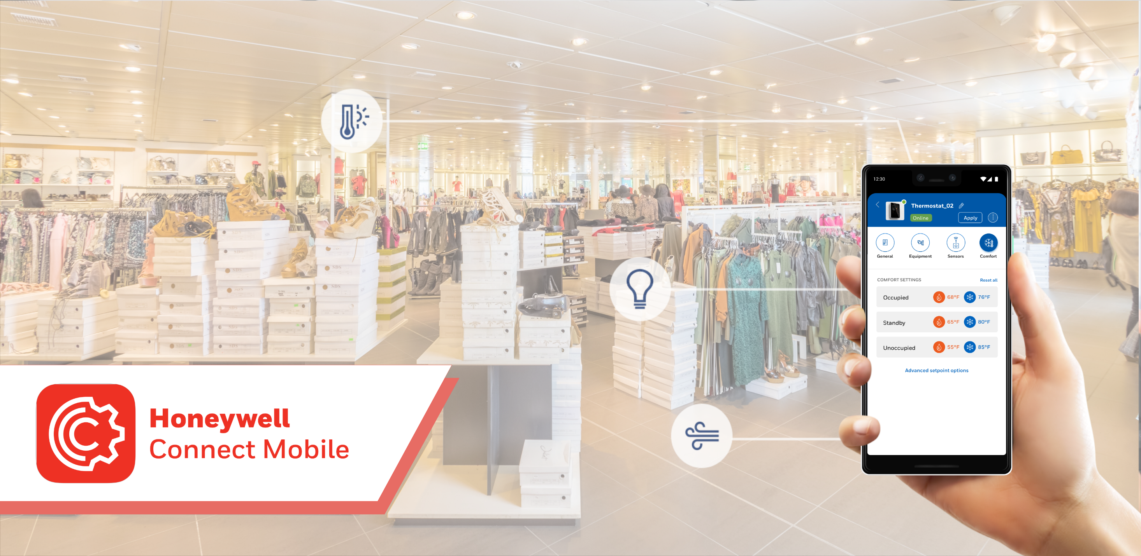

Slide 15
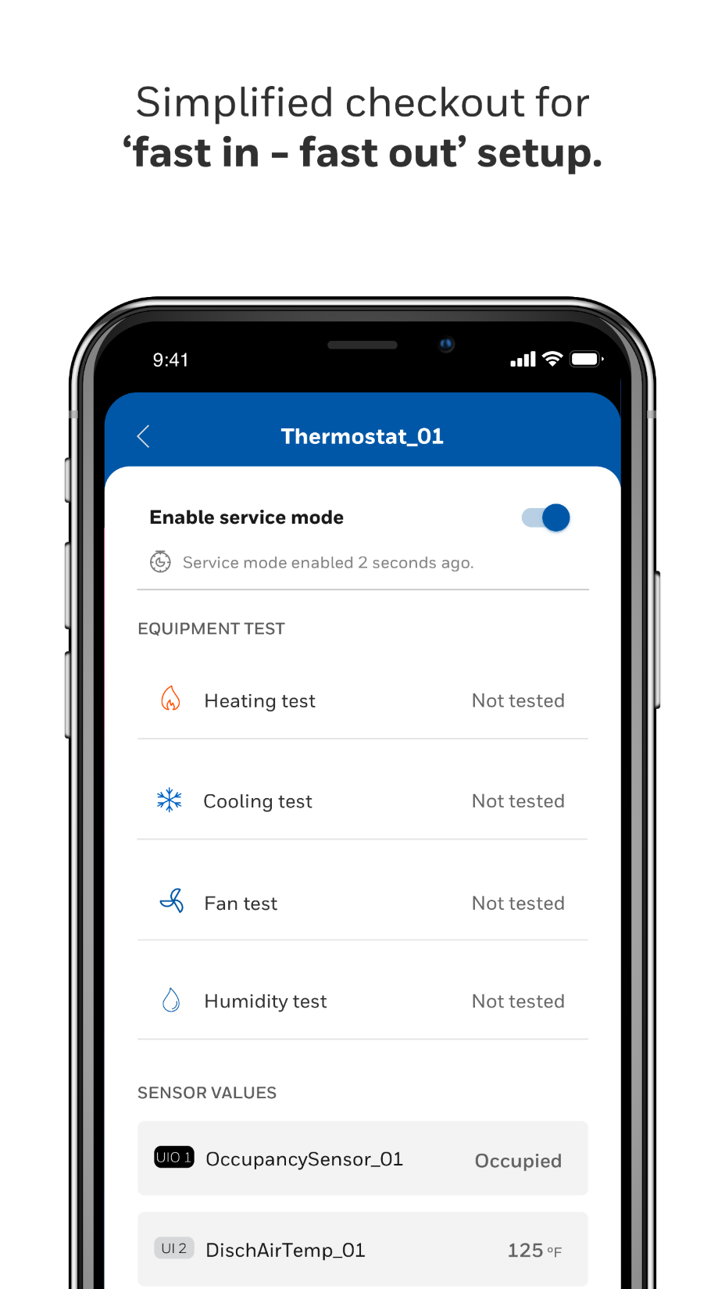
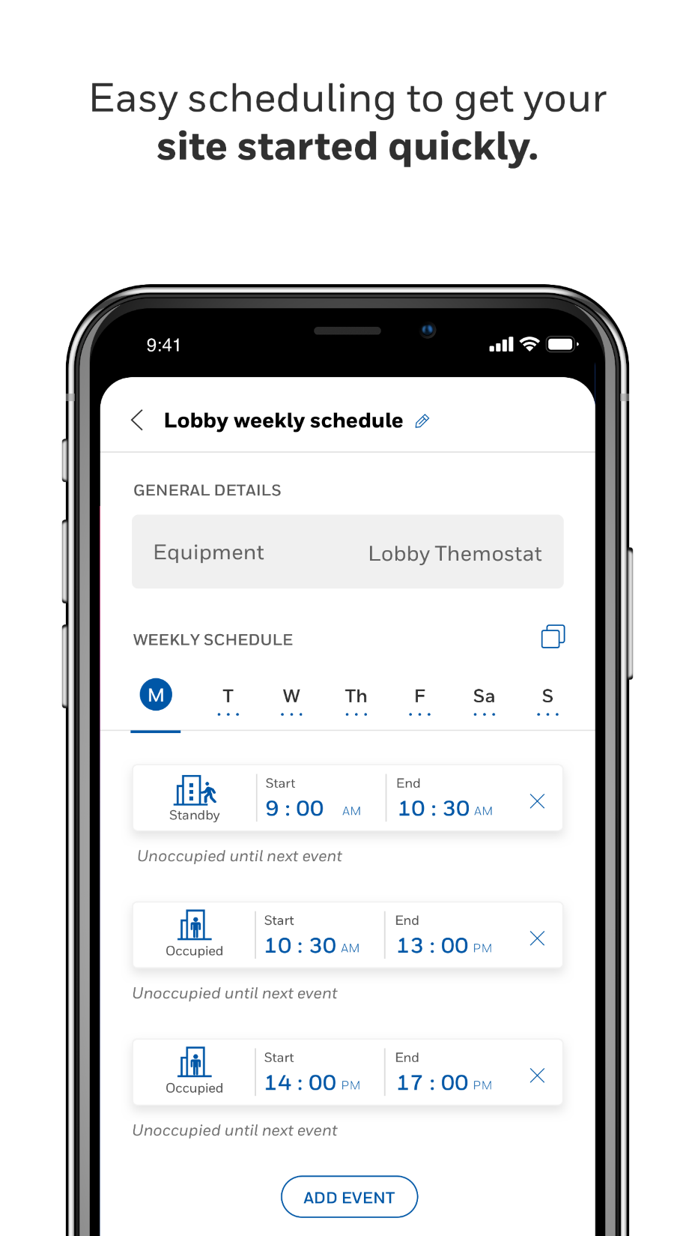
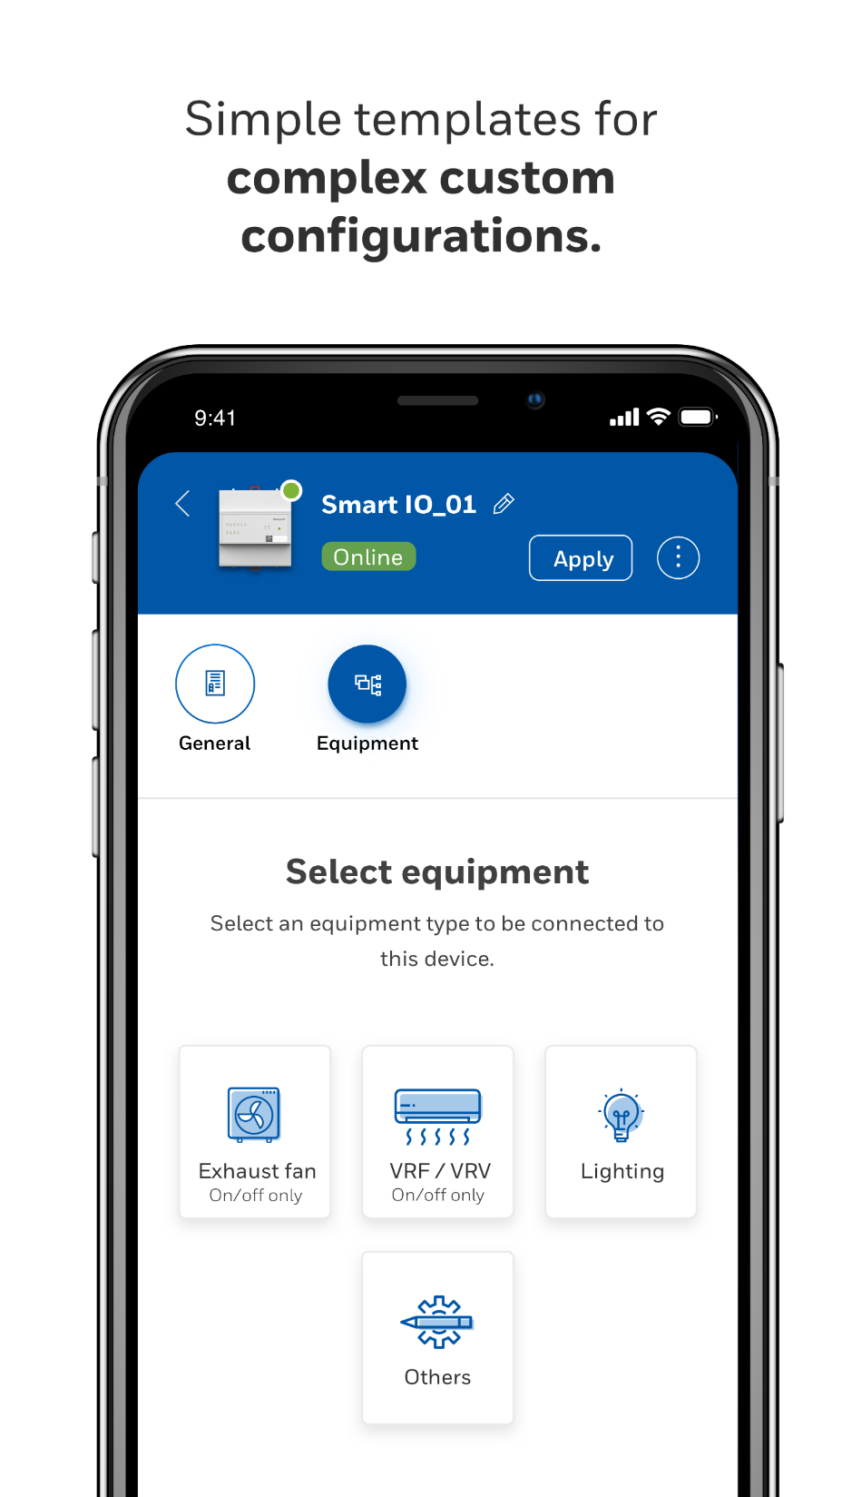
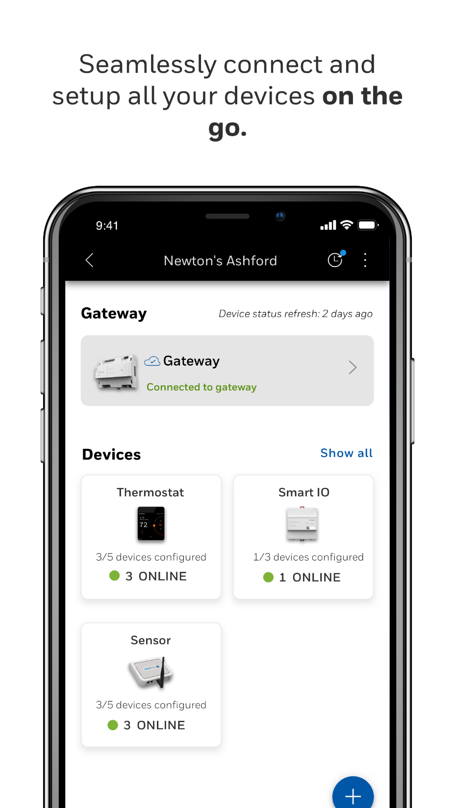

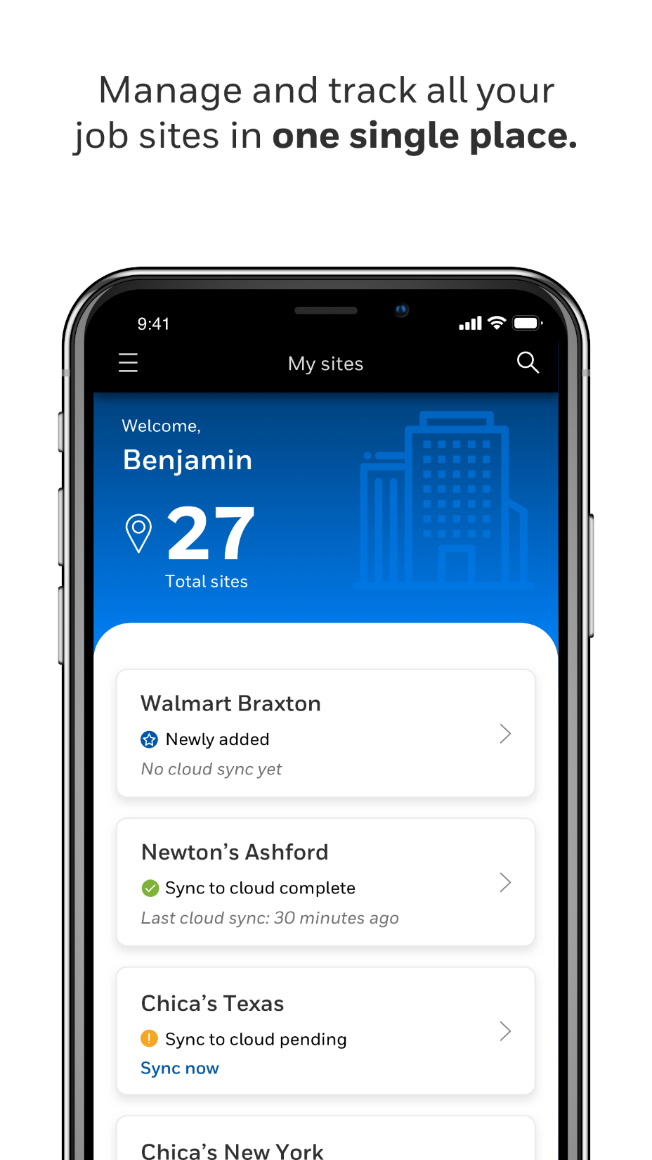
Self Sign-Up
  Create and manage accounts, add sites and devices, manage connectivity, app & user settings
Basic & Advanced Configuration
  Copy configuration, create template, thermostat name, contractor details, occupancy setpoints, manage connectivity, display preferences
Scheduling, Alarm & Reminder Configuration
Site Management

Slide 16


Onboarding
  Pair thermostat, register for mobile access, self sign-up, common settings, add site
Site and thermostat level management
Home screen
  Summary view of all t-stats in a site, view a site w/o t-stat, schedule override, thermostat mode
Scheduling and Alarms
  Copy schedules to other thermostats
  View and acknowledge alarms

Slide 17

On-demand TRAINING
Register for an account at My Honeywell Building University and search "TC500" or visit:
https://myhoneywellbuildingsuniversity.com/training/search/tc500

Slide 18
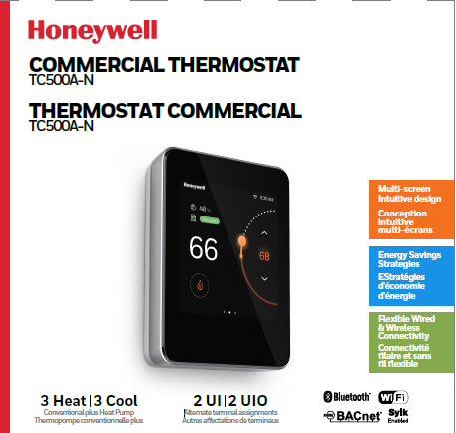
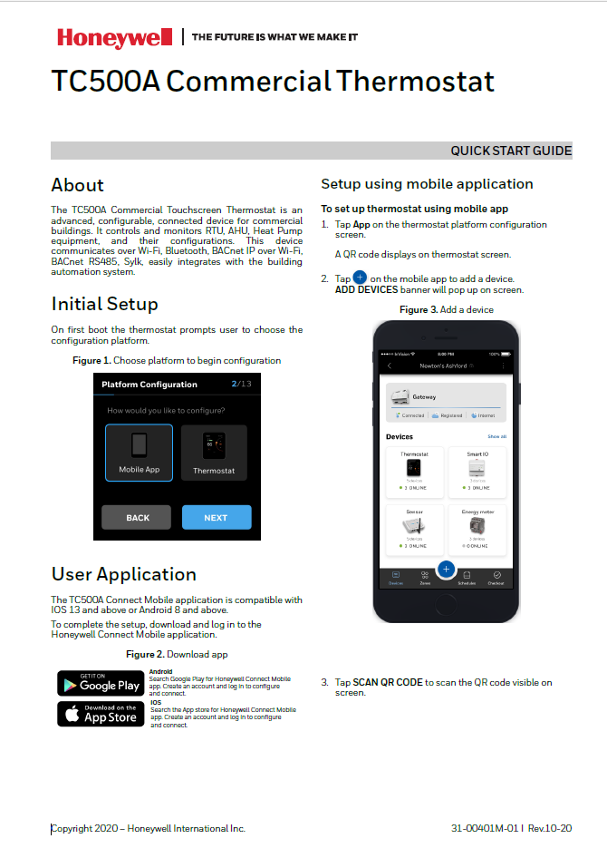
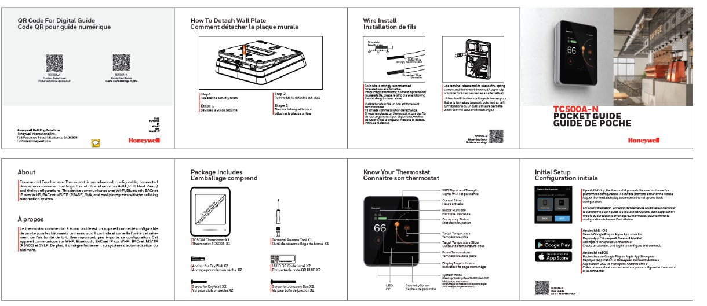
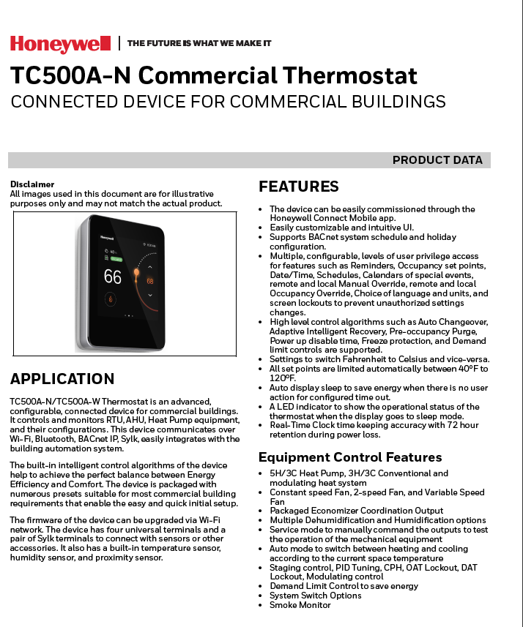



Technical support
Package (EN, FR, SP)
Quick Start Guide
Pocket Guide
Technical Documents
Pocket Guide
Package
Quick Start Guide
Datasheet
Mounting Guide
User Guide
CE Guide Specs
Commissioning/Install On-Demand Video Training Module
BACnet Guide
Datasheet
User Guide
Mounting Guide

Slide 19
















Marketing support
Counter Displays
Selection Guide
Video (and Video Shorts)
Press Release
Counter Mat
Plus…
Sales/Marketing On-Demand Training Module
Digital Media Graphics
Product Images
and more…
White Paper
Sell Sheet
Notes:
https://buildings.honeywell.com/us/en/brands/our-brands/bms/field-devices/tc500a_commercial_thermostat

Slide 20


ORDERING INFORMATION
Product Number | Description | Operating Voltage
TC500A-N | AHU/RTU/Heat Pump Commercial, Connected Thermostat | 24 VAC
DECOPLATE-N | Decorative Wall Cover Plate | -
CPQ
Configure, Price & Quote Site
https://www.cpq.honeywell.com/eCommerce#/sub/a1m1R000003VD6AQAW
My Buildings
eCommerce Purchase Site
https://buildings.honeywell.com/shop/honeywell/en/Honeywell-Products/Products/By-Brand/Honeywell-BMS-NA/TC500A-Commercial-Thermostat/p/TC500A-N

Slide 21

Superior value and simplicity
Single SKU Delivers Industry Leading Capabilities
Unmatched Equipment Compatibility
WiFi Connectivity and Remote Mobile App Control
Mobile App Configurability
Flexible BMS Integration (Wired and Wireless)
Multi-Level User Access
Intuitive User Interface & Aesthetic Appearance
Flexible, Configurable I/O
Ability to Grow with Your Business

Slide 22

21

Slide 23
Thank you
Stay tuned for additional information.

